Slide 1
OAKDALE HIGH SCHOOL BASKETBALL
2022-23
Coach Kelly Nasrawi
“Coach Nas”

Slide 2

Welcome to the Mustang Family!
Congratulations! Your daughter is officially part of the Mustangs Basketball Family! Thank you for entrusting us with the job of mentoring and coaching your student- athlete.
Once a Mustang, always a Mustang!

Slide 3

Tryouts
Tryouts were on:
Monday, October 31st
Tuesday, November 1st
Wednesday, November 2nd
Athletes will be placed on each team:
  Freshman= freshman ONLY
  JV= freshman & sophomores
  Varsity= freshman through seniors

Slide 4
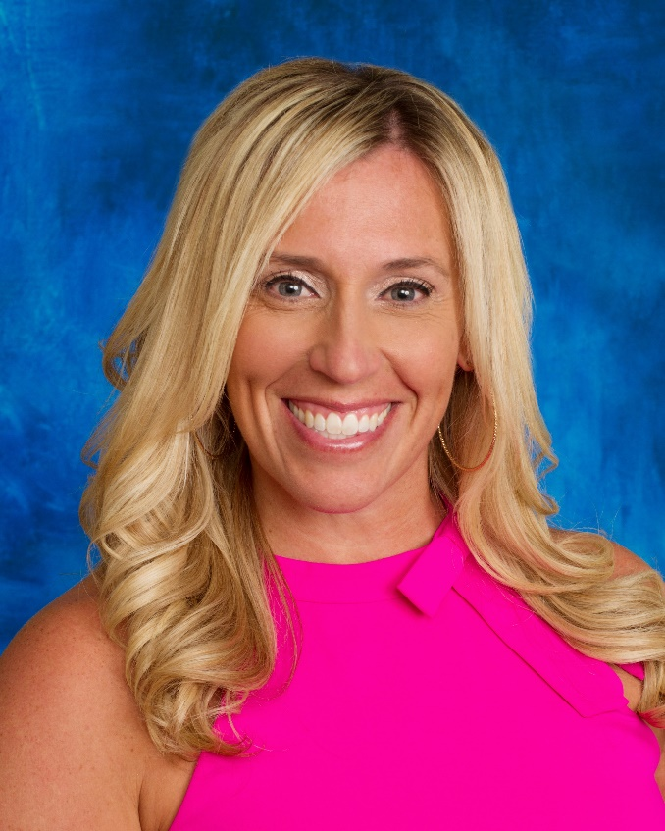
Coaching Staff
Kelly Nasrawi, Head Coach
    21 years of coaching experience
        11 years as a college coach
        10 years coaching H.S. sports– volleyball, basketball, and softball
    4 years Varsity Volleyball in H.S.
    2 years Varsity Basketball in H.S.
    Played Division I softball for 4 years
    2nd year as Oakdale’s Head Coach
Contact information: knasrawi@ojusd.org

Slide 5
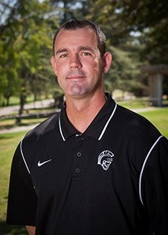
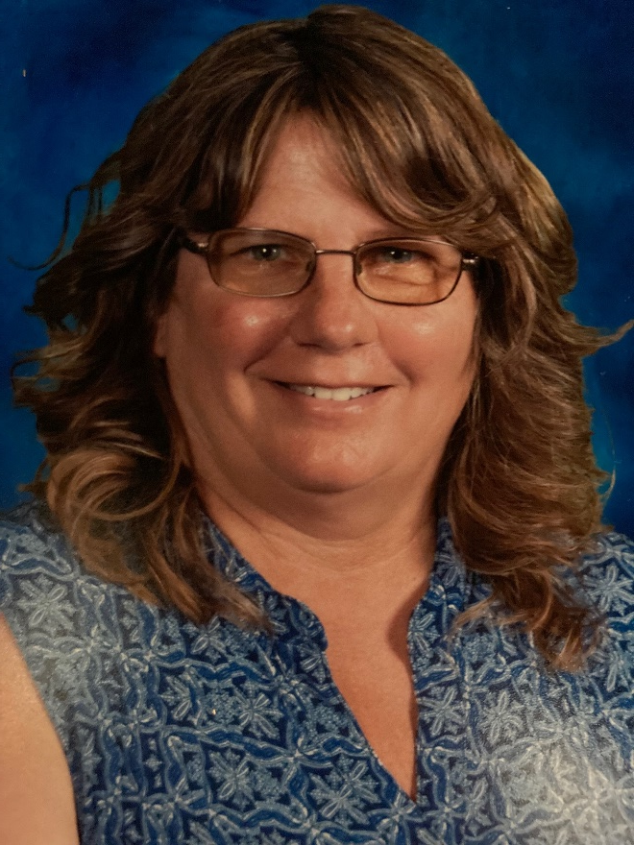
Coaching Staff
Ben Riley, Varsity Assistant Coach
Cheri Martin, JV Coach

Slide 6
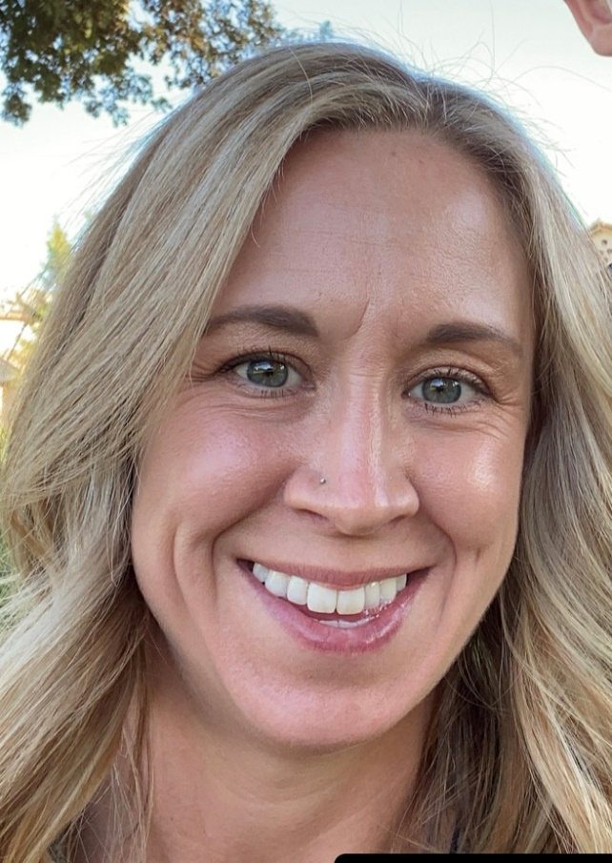
Coaching Staff
Kayla Port, Freshman
Co-Coach TBD, Freshman

Slide 7

Oakdale Basketball Mission Statement
​The Oakdale High School Girls Basketball Program aims to provide our young women with the opportunity to develop their athletic ability to their full potential in an environment that promotes high academic standards. The coaches are committed to preparing student-athletes for competition at the high school level by helping our young ladies develop the basic mental and physical skills of basketball, ultimately building strong and confident athletes. It is our goal to provide a positive environment, fostering teamwork, good sportsmanship, hard work, and core values. We strive to provide positive memories, while preparing our student-athletes for college and for life ahead.

Slide 8
Oakdale Basketball Vision Statement
​Our goal is to build a competitive and successful girls basketball program at Oakdale High School and produce high school graduates, champions, and productive citizens in our community. The basketball program will encourage and inspire the quest for excellence on and off the court through effort, commitment, integrity, determination, and perseverance. Our highest priority is to reinforce the academic mission of OHS and maximize the educational growth of our student-athletes. The basketball program is fully committed to academic excellence and success. The purpose of our program is to provide a safe and positive environment in which athletes will receive the necessary training to be competitive and successful in high school basketball. Our coaching staff is dedicated to working with all student-athletes to achieve a common goal. The athletic experience of the student-athletes will be exciting and rewarding as they build strong character and effective life skills that they can take with them in their future endeavors.

Slide 9

Booster Club
We encourage you to join the Oakdale High School Booster Club and actively participate as well.
  Please check our Google Classroom for the Sports Boosters Sponsorship Form, which can be found in the “RESOURCES” module.
  We also hope that you will volunteer to help when we are required to do our part!

Slide 10


Player Expectations
Grades
  Go to all classes, be on time, be respectful, & ask questions.
  Be a model student.
  Mandatory Study Hall
    “Team Talk” Mondays at lunch and away game study sessions
Behavior/Attitude
  Be respectful… ROOTS= Respect Rules, Opponents, Officials, Teammates, and Self
  Be selfless… Put the team before self.
    Playing time, stats, team records don’t define you or success. What you’ll remember most are the experiences and relationships created through playing sports.
  Follow team and school rules at all times.
  Be a positive team player.
  Honor your commitments.
  Communication… Talk to your coaches, not about them. Talk to your teammates,
  not about them.
  Be responsible, accountable, loyal, and honest.
  Be coachable and a great teammate.
Attendance
  Be present… Be on time… Work hard… Put forth effort.
  There will be consequences for missing scheduled events.

Slide 11

Parent/Guardian Expectations
Support your student-athlete.
  Please look at the team manual that we provided. It will help you understand our philosophy
Teach your daughter that she should be first to communicate with a coach. Teach them how!
Be proud of them for their effort and commitment.
Hold them accountable.
Allow coaches to coach!
Communication with coaches
  The Mustangs Basketball program has an open-door policy.
  Playing time is the coach’s decision
  After following communication steps, discuss any concerns with the immediate coach. Please do not bypass the head coach. There is an order of operations.
  Email the head coach with questions and/or concerns.
  Please adhere to the 24-hour policy. DO NOT confront a coach after a practice, game, etc.

Slide 12

Dress Code
Student-athletes need to adhere to the school and district policy dress code at all times.
REQUIRED: basketball/court shoes, basketball shorts (appropriate length) and socks. All gear must be in team/school colors.
Team Jerseys, practice gear, warm-ups, etc. will be provided. It is the responsibility of the athlete to take care of everything she is given. This includes proper washing/drying.
Only Oakdale colors (black, red, white, yellow, & possibly gray) will be allowed at practices and games.
Varsity leaders will determine the daily dress code.

Slide 13

Playing Time
Playing time will be determined by 3 factors:
  Attendance– refers to “showing up” both physically and mentally to practices, games, & other team activities
  Attitude– refers to a positive “I can” attitude, willing to try what is asked of her (be coachable), and supportive of her teammates
  Skill– refers to the physical and mental capabilities when completing required movements and plays
Playing time will not always be equal.
We place an emphasis on positive attitude, hard work, progress, and improvement.
A high level of skill DOES NOT ensure playing time!

Slide 14


Fundraising
We are not a fully funded program. Raising money is a key component to high school sports.
My goal= minimal work with maximum returns!
Student-athletes are expected to carry their weight and fulfill their commitment to raising funds.
Fall Dinner Fundraiser– Thursday, October 21st @ House of Beef
  Each player was required to minimally sell 2 tickets and work with a partner to find a silent auction item.
  We raised approximately $3,500
We encourage you to join the OHS Booster Club and actively participate as well.
  We are required to work the concessions during the football season for Boosters and we need parents to volunteer to help!
Game Day Concessions
    Please volunteer to help! You can work when your child/athlete is NOT playing.

Slide 15

Volunteerism
It is very important to be outstanding citizens and members of our community.
There will be several “mandatory” volunteer opportunities to give back to the community we live in.
      November- Thanksgiving in a Box
      December- Food & Toy Distribution
      February- “A Night to Shine”
      March- Modesto Marathon
Please support and encourage your student-athlete to attend and participate in these activities.

Slide 16

Transportation & Travel
Buses will be provided for ALL away games.
Athletes MUST ride the bus to and from competition.
Requests to ride with family will be denied except in extenuating circumstances.
Plan ahead… away games will be long days. Your child needs to eat! Please make sure she has food and/or money for the long day.
Study Hall may be provided at the opposing schools. Student-athletes need to be prepared to work.
Please be at OHS to pick up your student-athlete when the bus arrives. They can call/text you within 30 minutes of our arrival. It is already a long day, the coaching staff does not want to wait nor will they provide rides home.
Plan ahead. Check the calendar for practice schedules and games to ensure your student-athlete has a ride to and from Oakdale HS.

Slide 17

Game Day Procedures
Your student-athlete will not be allowed to talk to family and friends at any time during competition. This includes warm-ups and clean up.
We ask that you support this team policy.
Please refrain from coaching your athlete from the stands. Just relax and enjoy the game!
If you have something for your student-athlete (i.e. Gatorade), please make arrangements with her prior to the game.
On certain days, your student-athlete will be required to work and/or stay for the other games. Please plan accordingly.

Slide 18


Slide 19


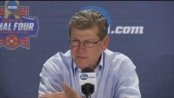


Slide 20

Goals and Hopes for the Season!
Improve basketball skills and knowledge
Create a structured environment and program we all can be proud of
Work hard
Get chances to compete in meaningful situations
Build relationships
Make memories
Have fun
WINNING is a bonus!

Slide 21




Final Thoughts
Any questions??
There will be a GroupMe for the girls in the program. It is important to have the app in order to receive important updates.
We also have a Google Classroom that all players should have access to.
https://classroom.google.com/w/Mzc0MjQ1MzExMDk3/t/all
Our official website:
http://ohsgirlsbball.weebly.com/
Follow us on Instagram:
  @ohs_mustangs_basketball

